Slide 1
LED blink on hardware
Tutorial
BESTIN AUTOMATION
An ISO 9001:2015 certified company
Proprietor: Amritpal Singh

Slide 2

LED (Light-emitting diode)
A light-emitting diode (LED) is a semiconductor device that emits light when an electric current flows through it.
LED Symbol

Slide 3
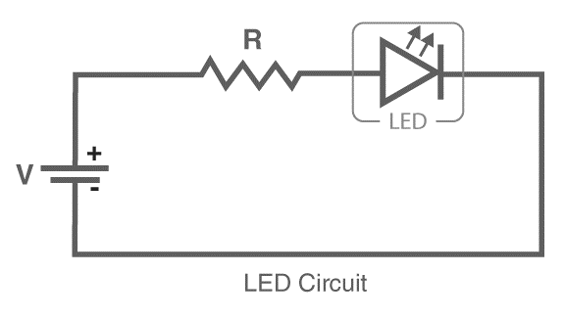
Simple LED circuit
The circuit consists of an LED, a voltage supply and a resistor to regulate the current and voltage.
resistor
Battery/Cell

Slide 4
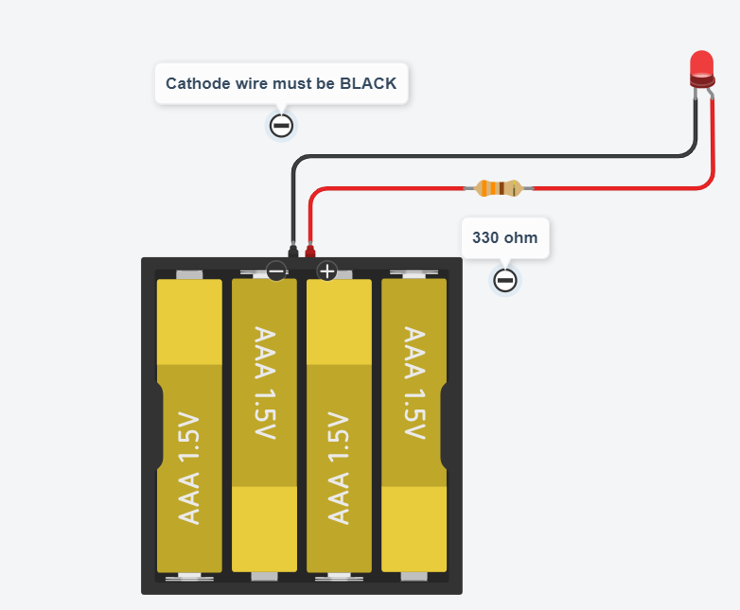
Simple LED circuit on TinkerCad

Slide 5
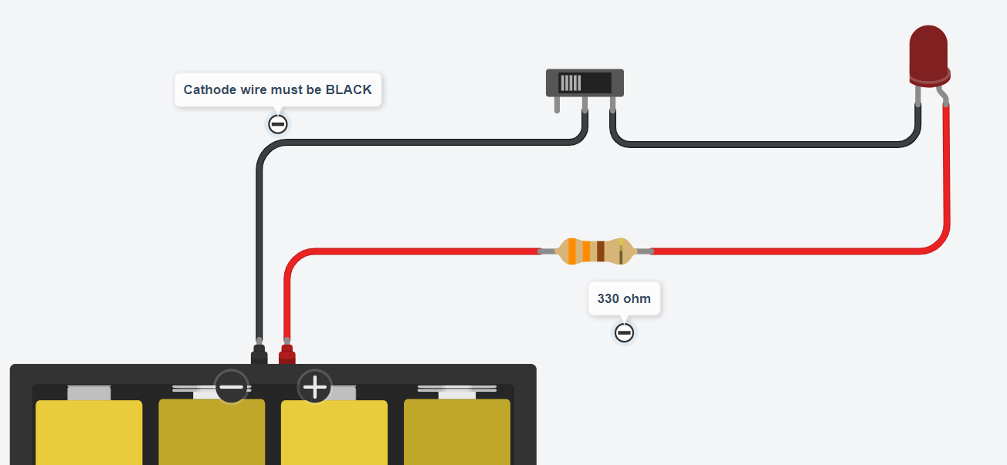
Simple LED and SWITCH circuit on TinkerCad
Slide Switch

Slide 6
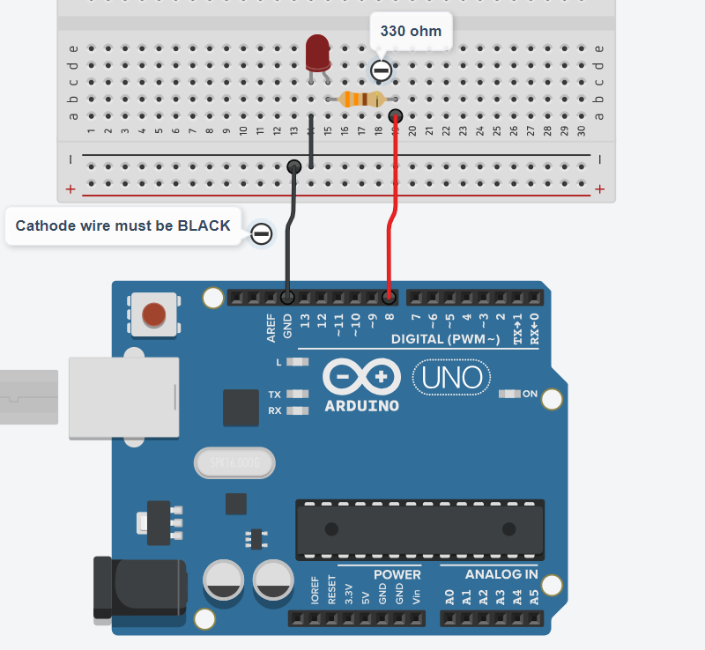
Led blink using hardware
Place these components one by one
Arduino
Breadboard
LED
Resistor
Jumper Wires
PLUG AND PLAY!

Slide 7

Explanation of code
Set Pin number
Set pin ON/OFF
HIGH means ON LOW means OFF
digitalWrite is a command to turn ON or OFF the pin
Delay means wait time
1000ms = 1 seconds

Slide 8
Thanks for your attention !
BESTIN AUTOMATION
An ISO 9001:2015 certified company

